Slide 1
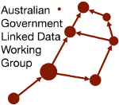
AGLDWG AGM 2026 Project Presentations
Multiple AGLDWG Members

Slide 2
Speakers
Melinda Hodkiewicz
Les Kneebone
Matt Duckham
Edmond Chuc
Heidi Leow
Nicholas Car
Alastair Paton
Adib Rohani
Jamie Feiss

Slide 3
Ontology-based interoperability of standards
Speaker: Melinda Hodkiewicz, UWA

Slide 4
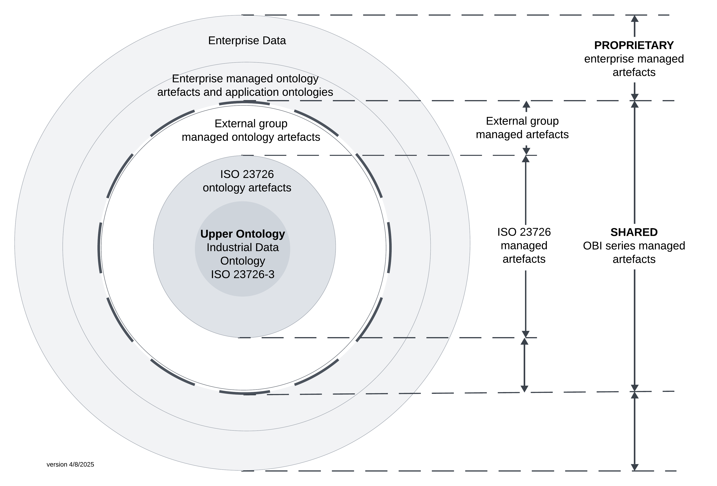
Why the Industrial automation systems and integration – Ontology based interoperability (OBI) standards?
The Ontology based interoperability (OBI) standards facilitate digitization in long-life, asset-intensive industries through a shared, digital representation of a system's physical and functional structures and interdependencies, and data captured as part of design, purchase, operation, and maintenance decisions through the life cycle.
Each part of the new standard utilizes IDO aligned models to represent knowledge, structured as OWL 2 DL compliant ontologies.

Slide 5
ISO/CD 23726-1 Overview and fundamental principles
Clause 1: Scope
Clause 2: Normative references
Clause 3: Terms and definitions
Clause 4: Parts of the OBI series
4.1 Overview and fundamental principles
4.2 Vocabulary
4.3 Industrial data ontology
4.4 Schedule data ontology
Clause 5: OBI ecosystem
5.1 General
5.2 Stakeholders in the OBI ecosystem
5.3 Reference ontologies
5.4 Ontology alignment
5.5 Reference data libraries
5.6 Reference to Semantic Web technologies
5.7 RDF vocabularies
5.8 Modelling templates, patterns and data quality rules-
For more information:
A pre-ISO submission version of Part 1 is available at:
https://pca-posc-caesar-association.github.io/Public_ISO23726-1/latest/
An FDIS version of the ISO ttl file is available at
https://posccaesar.org/articles/fdis-version-of-ido---industrial-data-ontology-now-available-for-download-as-a-file
Contact: Melinda.Hodkiewicz@uwa.edu.au
Clause 6: Fundamental principles and requirements
6.1 Direct Semantics consistent
6.2 Resource description framework
6.3 Digital resource
6.4 Axioms, rules and constraints
6.5 Ontology alignment, review and documentation
6.6 Annotation
6.7 Versioning and storage of artefacts
6.8 Ontology modularisation and re-use
6.9 Ontology evaluation
6.10 Ontology maintenance agencies and process
Clause 7: Grounding in mathematical logic
Clause 8: Ontology namespace, formatting and annotation guidelines
8.1 Ontology identifier structure and namespace
8.2 Ontology subdirectory structure
8.3 Namespace for ontology resources
8.4 Otology prefixes
8.5 Class names
8.6 Object property names
8.7 Data property names
8.8 Alignment ontologies
Clause 9: Annotation properties

Slide 6
Modelling ATED as a Semantic Web vocabulary
Speaker: Les Kneebone, KurrawongAI

Slide 8
Linked Data Road Networks
Speaker: Matt Duckham, RMIT

Slide 9
GeoSPARQL Implementation
Speaker: Edmond Chuc, KurrawongAI

Slide 10
Carapace
Speaker: Heidi Leow, UWA

Slide 11
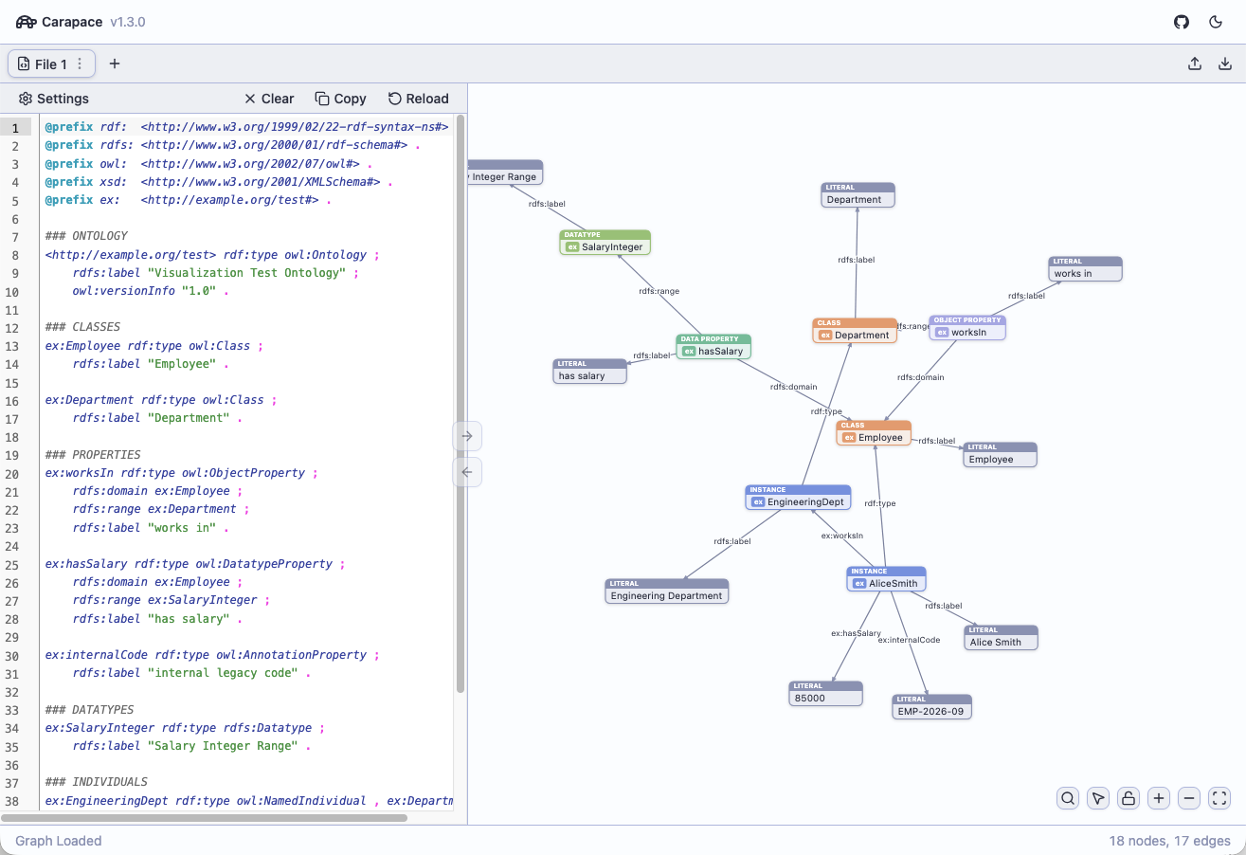

Slide 12
RDFLib & Family
Speaker: Nicholas Car, KurrawongAI

Slide 13



RDFLib: Open-Source Python package for working with RDF
Quickstart
Roles Easy scripting, teaching, infracode, W3C proofs
History/Future 2002 – now! / 8.0.0 in 2026. Python & W3C influences forward Family https://rdflib.dev, but now also kurra & KGM
Click me:
https://rdflib.dev
from rdflib import Graph g = Graph() g.parse(“my-file.ttl”) for r in g.subjects((RDF.type, SKOS.Concept)): print(r[0])

Slide 14
AGLDWG/Finance CA3 Project Peer Review
Speaker: Alastair Paton, independent

Slide 16
Producing High-Quality Semantic Representations of Standards
Speaker: Adib Rohani, UWA

Slide 17
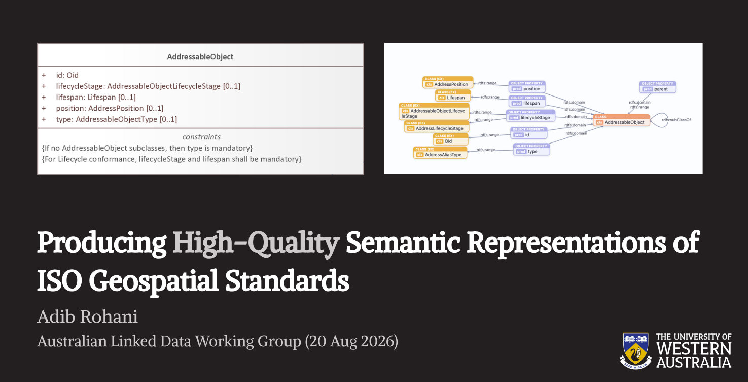

Slide 18
IDN Metadata Entry Tool
Speaker: Jamie Feiss, Uni Melbourne

Slide 19
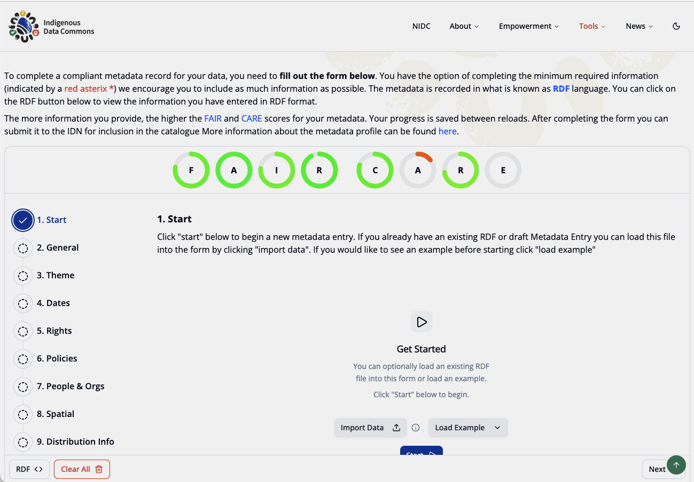

Slide 20
Australian Government Linked Data Working Group contact:
http://www.linked.data.gov.au

